Slide 1
Bootstrap your app!
With aws-amplify

Slide 2





































TITANIUM SPONSORS
Platinum Sponsors
Gold Sponsors

Slide 3
Hello, my name is mat warger
~10 years of software experience
Involved in finance, marketing, insurance, sports industries – from startups to enterprise
Full-stack, diverse background
Currently @KeyholeSoftware
Twitter/Medium/Github @mwarger

Slide 4



Slide 5
What is amplify?
Client-side library from Amazon
Integration with AWS Mobile Hub for services including:
API Gateway and Lambda
AppSync for GraphQL
S3 (user storage e.g. photos)
Authentication with Cognito
Pinpoint for analytics and push notifications
…and MORE

Slide 6


Why is amplify?
Abstracts away common use-cases
Centralized configuration
Service provisioning
CLI (awsmobile)
Utility classes and components

Slide 7

where is amplify?
Open-source on Github
Web - React, Angular, Vue, Vanilla
Mobile – React Native, Android, and iOS
Anywhere else you want – built with plugins and extensibility in mind
Integration with AWS out of the box

Slide 8
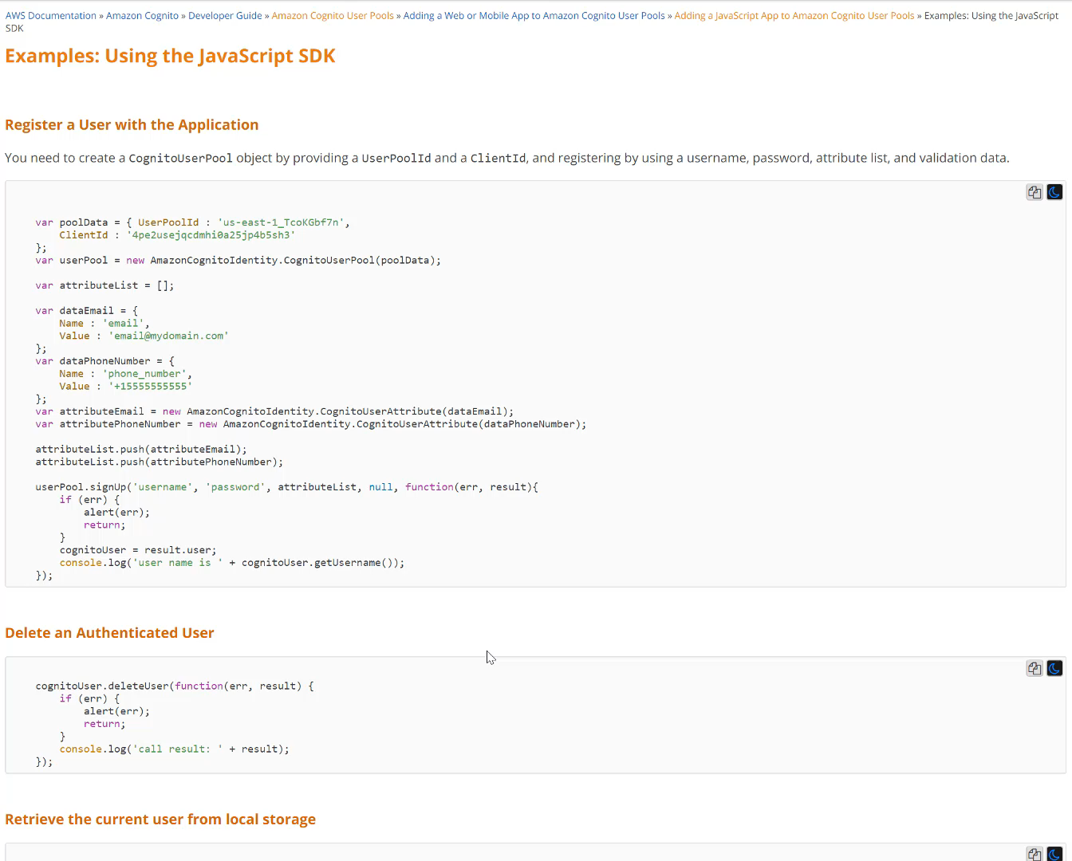

Slide 9
Mobile hub
Feature management and dashboard

Slide 10
AWSMObile CLI
Enabling and syncing project configuration

Slide 11
Authentication
Cognito user pools and federated identities (facebook/google/enterprise)

Slide 12
API Gateway and lambda

Slide 13
S3 for file storage

Slide 14
GraphQL and appsync

Slide 15
analytics

Slide 16
hosting

Slide 17
Other features & Recent additions
Service worker support
Chat bots
PubSub for IoT
Internationalization support
Localized cache and message service

Slide 18
Resources
https://github.com/mwarger/games-app-react
https://github.com/mwarger/games-app-api
https://aws.github.io/aws-amplify/
@mwarger

